Slide 1
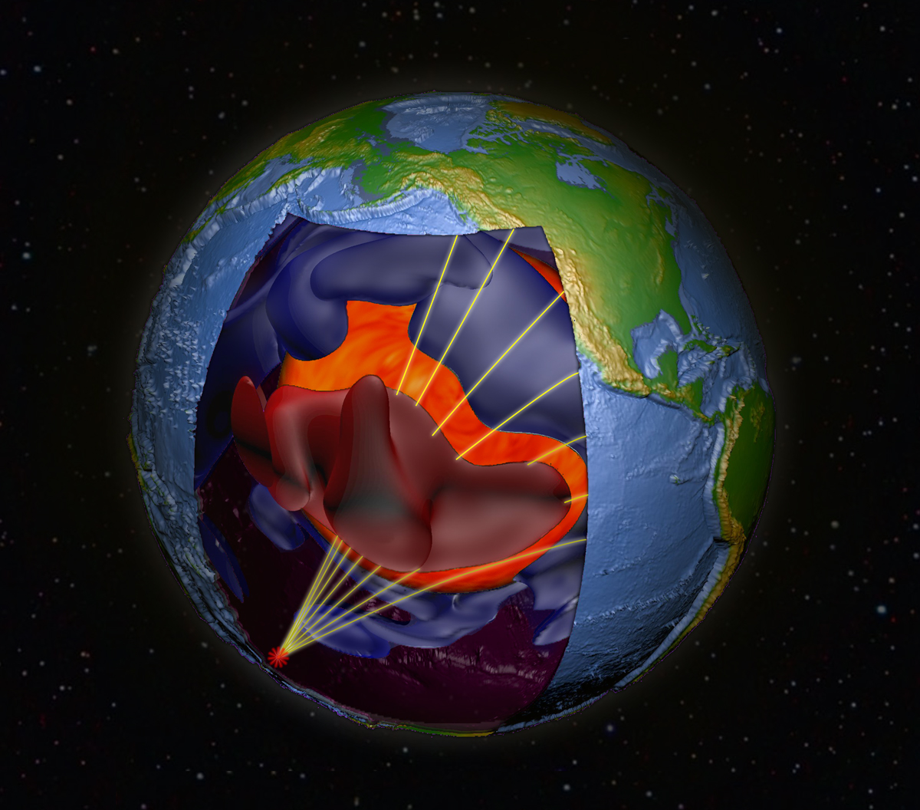
Seeing with seismology:
Earth’s core is on the move
Daniel A. Frost
Notes:
Hello,
Did you know that standing here on the Earth’s surface, we know what is in the centre of the planet, 4000 miles beneath us, and we know that down to the size of crystals.
I’m going to take you on a journey to the centre of the Earth, where I’ll show you that not all is quiet: the Earth’s core is moving.

Slide 2
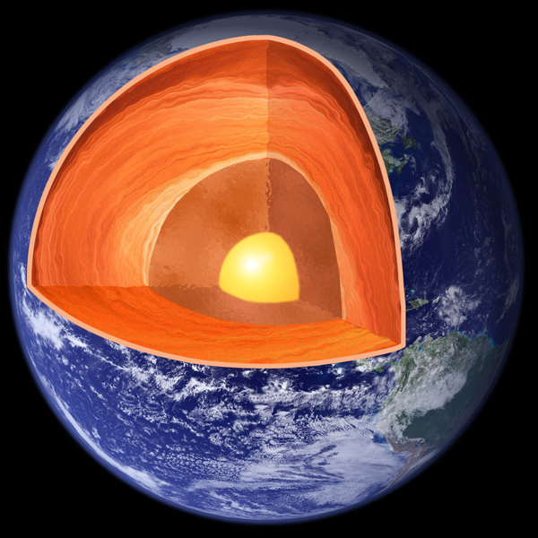
What we think we know
Solid Rock
Crust
Solid Rock
Mantle
Liquid Metal
Outer Core
Solid Metal
Inner Core
Notes:
We’ve been working to find out what’s inside the Earth for over a hundred years.
At present, we know that the Earth has a crust and mantle, which are made of rock.
Beneath the rocky layers, the Earth has a core,
We know that it’s made of mostly iron, it’s hot, and there’s an inner core that is solid, crystalline metal
We think that the inner core has existed for half a billion years

Slide 3
How we know it
What we know | How we know
Core | Seismology
Iron (mostly) | Cosmochemistry, seismology
Hot | Physics, seismology
Solid inner | Seismology, space physics
Crystalline | Seismology, mineral physics
Half a billion years old | Magnetism, mineral physics
Notes:
We have several tools that we use to determine what the core is like.
We can use observations from seismology, the chemistry of the solar system, the physics of materials, space physics, mineral physics, and geomagnetism.
Seismology is the tool that I use.

Slide 4
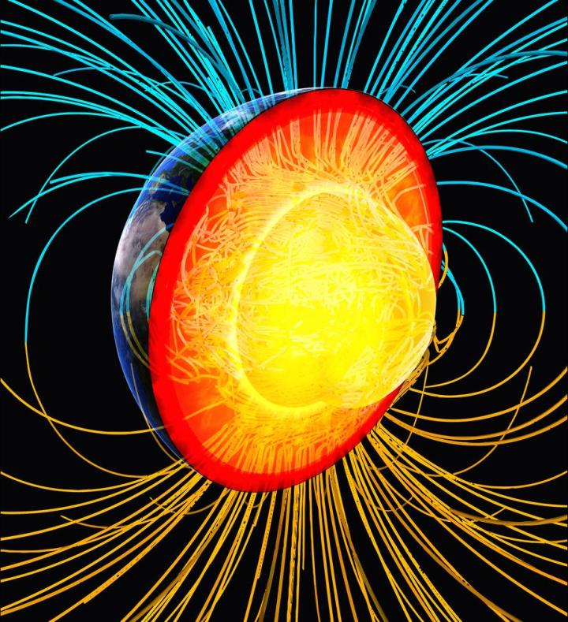
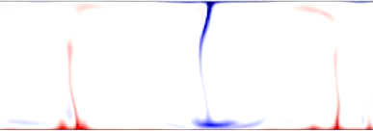
Why it matters
[Glatzmaier and Roberts]
Heat from inner core
[Allen McNamara]
Notes:
Despite being only about 1 percent of the volume of the whole Earth and being buried over 3000 miles down, the inner core affects us here on the surface every day.
The layer above the inner core, the liquid iron outer core, is the source of the Earth’s magnetic field.
As well as being used for navigation, the magnetic field shields the Earth from the solar wind
The outer core is heated from below by the freezing of the inner core
As the inner core cools and crystallises, it gives off heat
The rate and location of freezing affects the heating of the outer core.
.

Slide 5
Why it matters
Magnetic field
Motion of conductor in magnetic field
Current in conductor
[Glatzmaier and Roberts]
Heat from inner core
[Allen McNamara]
Notes:
Hot outer core material is less dense and rises, and cold material is more dense and sinks.
This movement of liquid iron in the outer core, within the Earth’s magnetic field, generates electrical currents which regenerate the magnetic field: like a giant dynamo.
Thus the way in which the inner core crystalises affects how the magnetic field operates.

Slide 6
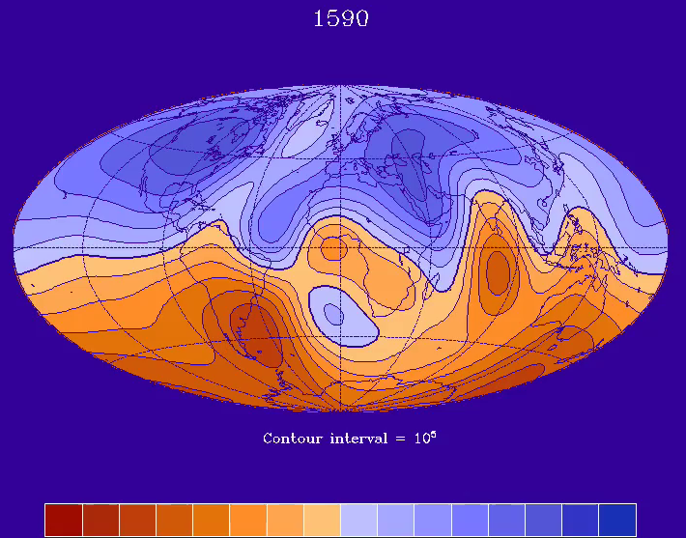
Measuring movement
The strength of Earth’s magnetic field
[Andrew Jackson]
Notes:
Compasses were essential for naviation from the fifteen hundreds onwards
From measuring the magnetic field on ships, we know that Earth’s magnetic field changes through time.
The whole of the Earth’s magnetic field is rotating to the West
The strength of the field has changed through time
And you may remember a news article from a few months ago about the magnetic north pole moving so much that compasses had to be recalibrated
While the magnetic field is produced by the outer core, the driving force of this is the inner core.
To understand how the magnetic field will change in the future, we must look backwards at how the magnetic field and the inner core have changed in the past
The inner core is a solid record of the outer core’s movement.

Slide 7
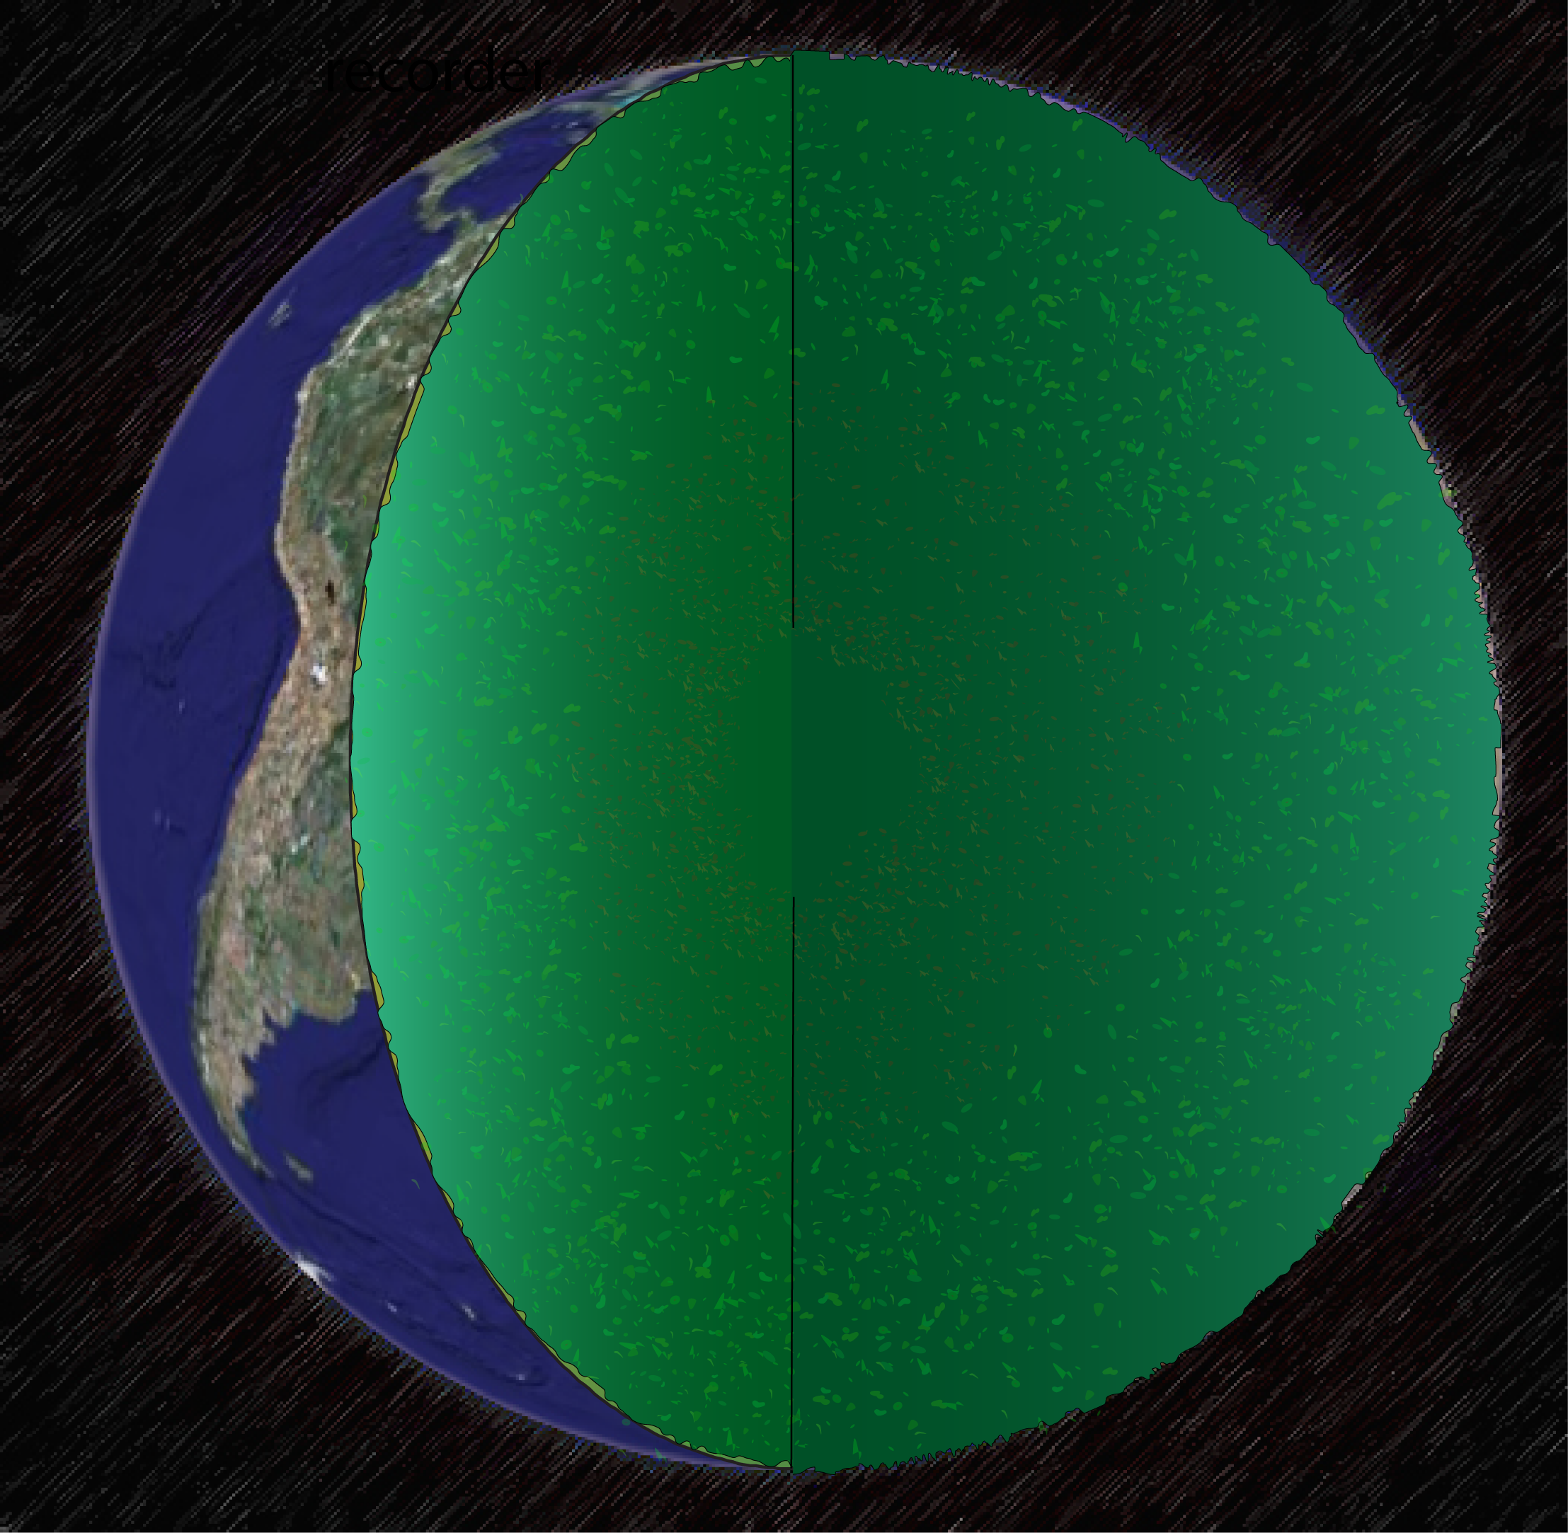
The Solid Earth
[Ed Garnero]
Notes:
This brings us back to the how.
How, standing on the surface can we say anything about the inside?
Moreover, how can we look backwards through time to learn how the inner core evolved?

Slide 8

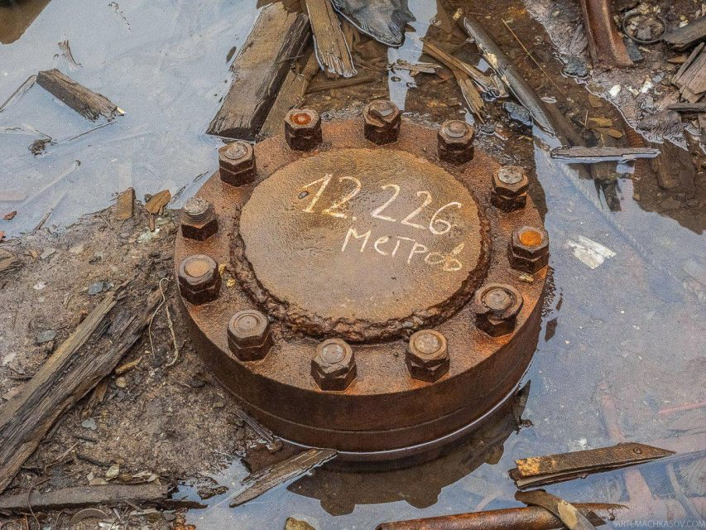
Drilling down
Mo-hole No hole
Kola Superdeep Borehole
Notes:
We have to use indirect observations to understand the interior.
People have tried to look directly, to drill down to understand the Earth inside, but with little success.
The was the Mo-Hole experiment that became known as the No-Hole.
And then the Kola Superdeep Bolehole which reached a grand total of 12,226 metres depth, or 7.6 miles, before it was abandoned.
The rock became so hot that the drill bit started to get soft and couldn’t drill further, and as soon as the drill was removed the pressure closed the hole back up.
To put that in perspective, the radius of the Earth is approximately 4000 miles, so 7.6 miles is about point zero 2 % of the way there.
This red line is scaled to the size of the Earth in this figure. The line is ten times longer than the Kola borehole was deep.
So clearly, we need a different method if we want to see what’s going on in the centre of the Earth
END 5 mins

Slide 9
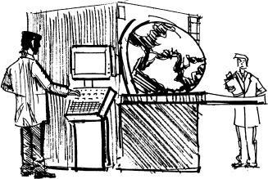
Seeing with seismology
[Redfern]
Notes:
While light can’t travel through the Earth, and nor can we, sound waves can
In the same way as we use ultrasound to look inside a body, we can use sound waves to look inside the Earth.
CLICK
But how do we put the Earth inside an ultrasound machine?

Slide 10

Seeing with seismology
[Mike Thorne, UoU]
Notes:
Earthquakes make sound waves.
Following an earthquake, seismic waves fan out in all directions, like ripples when you throw a stone into a lake.
While we feel shaking at the Earth’s surface, caused by what are called “surface waves”
Some waves travel all the way through the centre of the Earth and it’s these that we can use to understand what’s deep inside
These seismic waves travel through the earth like sound waves travel through a body
By analysing waves from Earthquakes we can take snapshots of the structure Earth as it is today

Slide 11
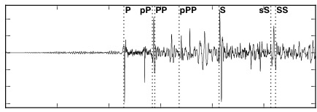

Using body waves to image the Earth
Notes:
Looking at just a single seismic wave we can understand how it carries information about the Earth
CLICK
The propagation speed of waves depend on the properties of the material through which it travels.
These wiggles are a typical recording, or seismogram, which shows the amount of shaking that a seismometer feels through time
From this we can pick out the arrival of waves.

Slide 12
Using body waves to image the Earth
T
T
D
V=D/T
Speed = Distance / Time
Notes:
We can measure the time it takes for a wave to travel some distance to determine the wave velocities, the seismic wavespeed
The wavespeed tells us about the properties of the material through which the wave passes

Slide 13
Using body waves to image the Earth
T-dT
dV
Seismically Fast
Notes:
If the wave were to pass through some volume with different material properties that would manifest in the travel time which we observe
CLICK
For example, passing through some faster part of the earth would result in the wave arriving earlier

Slide 14
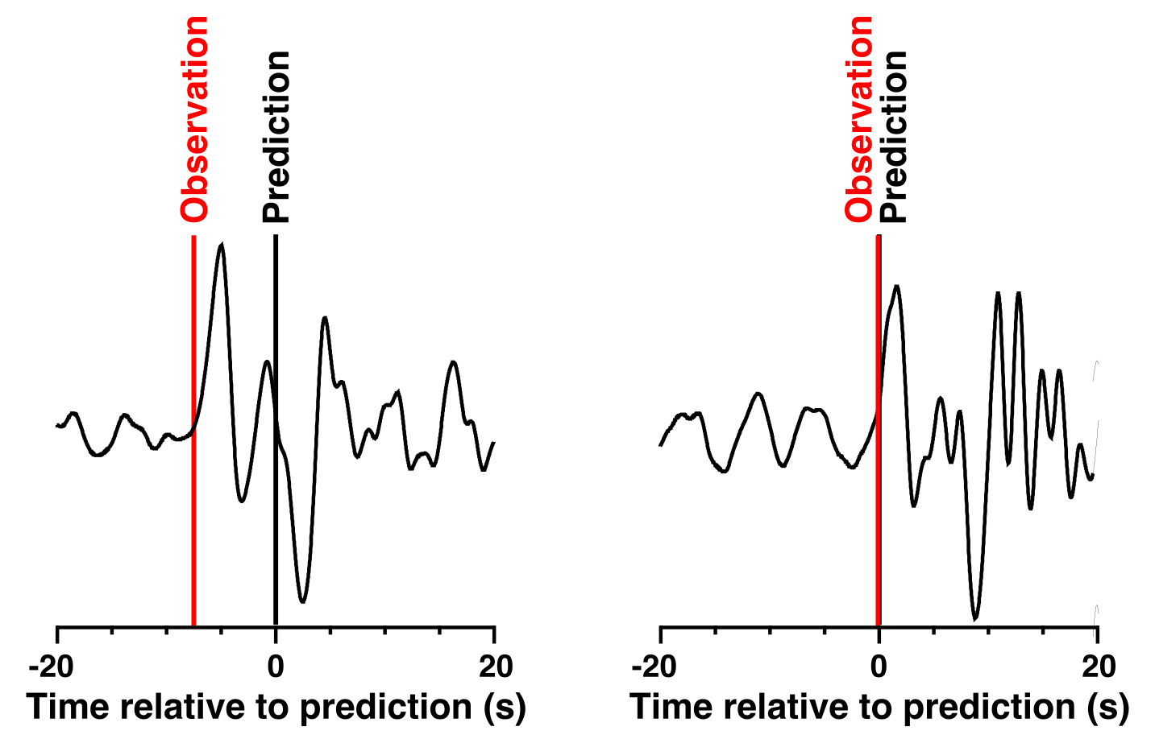
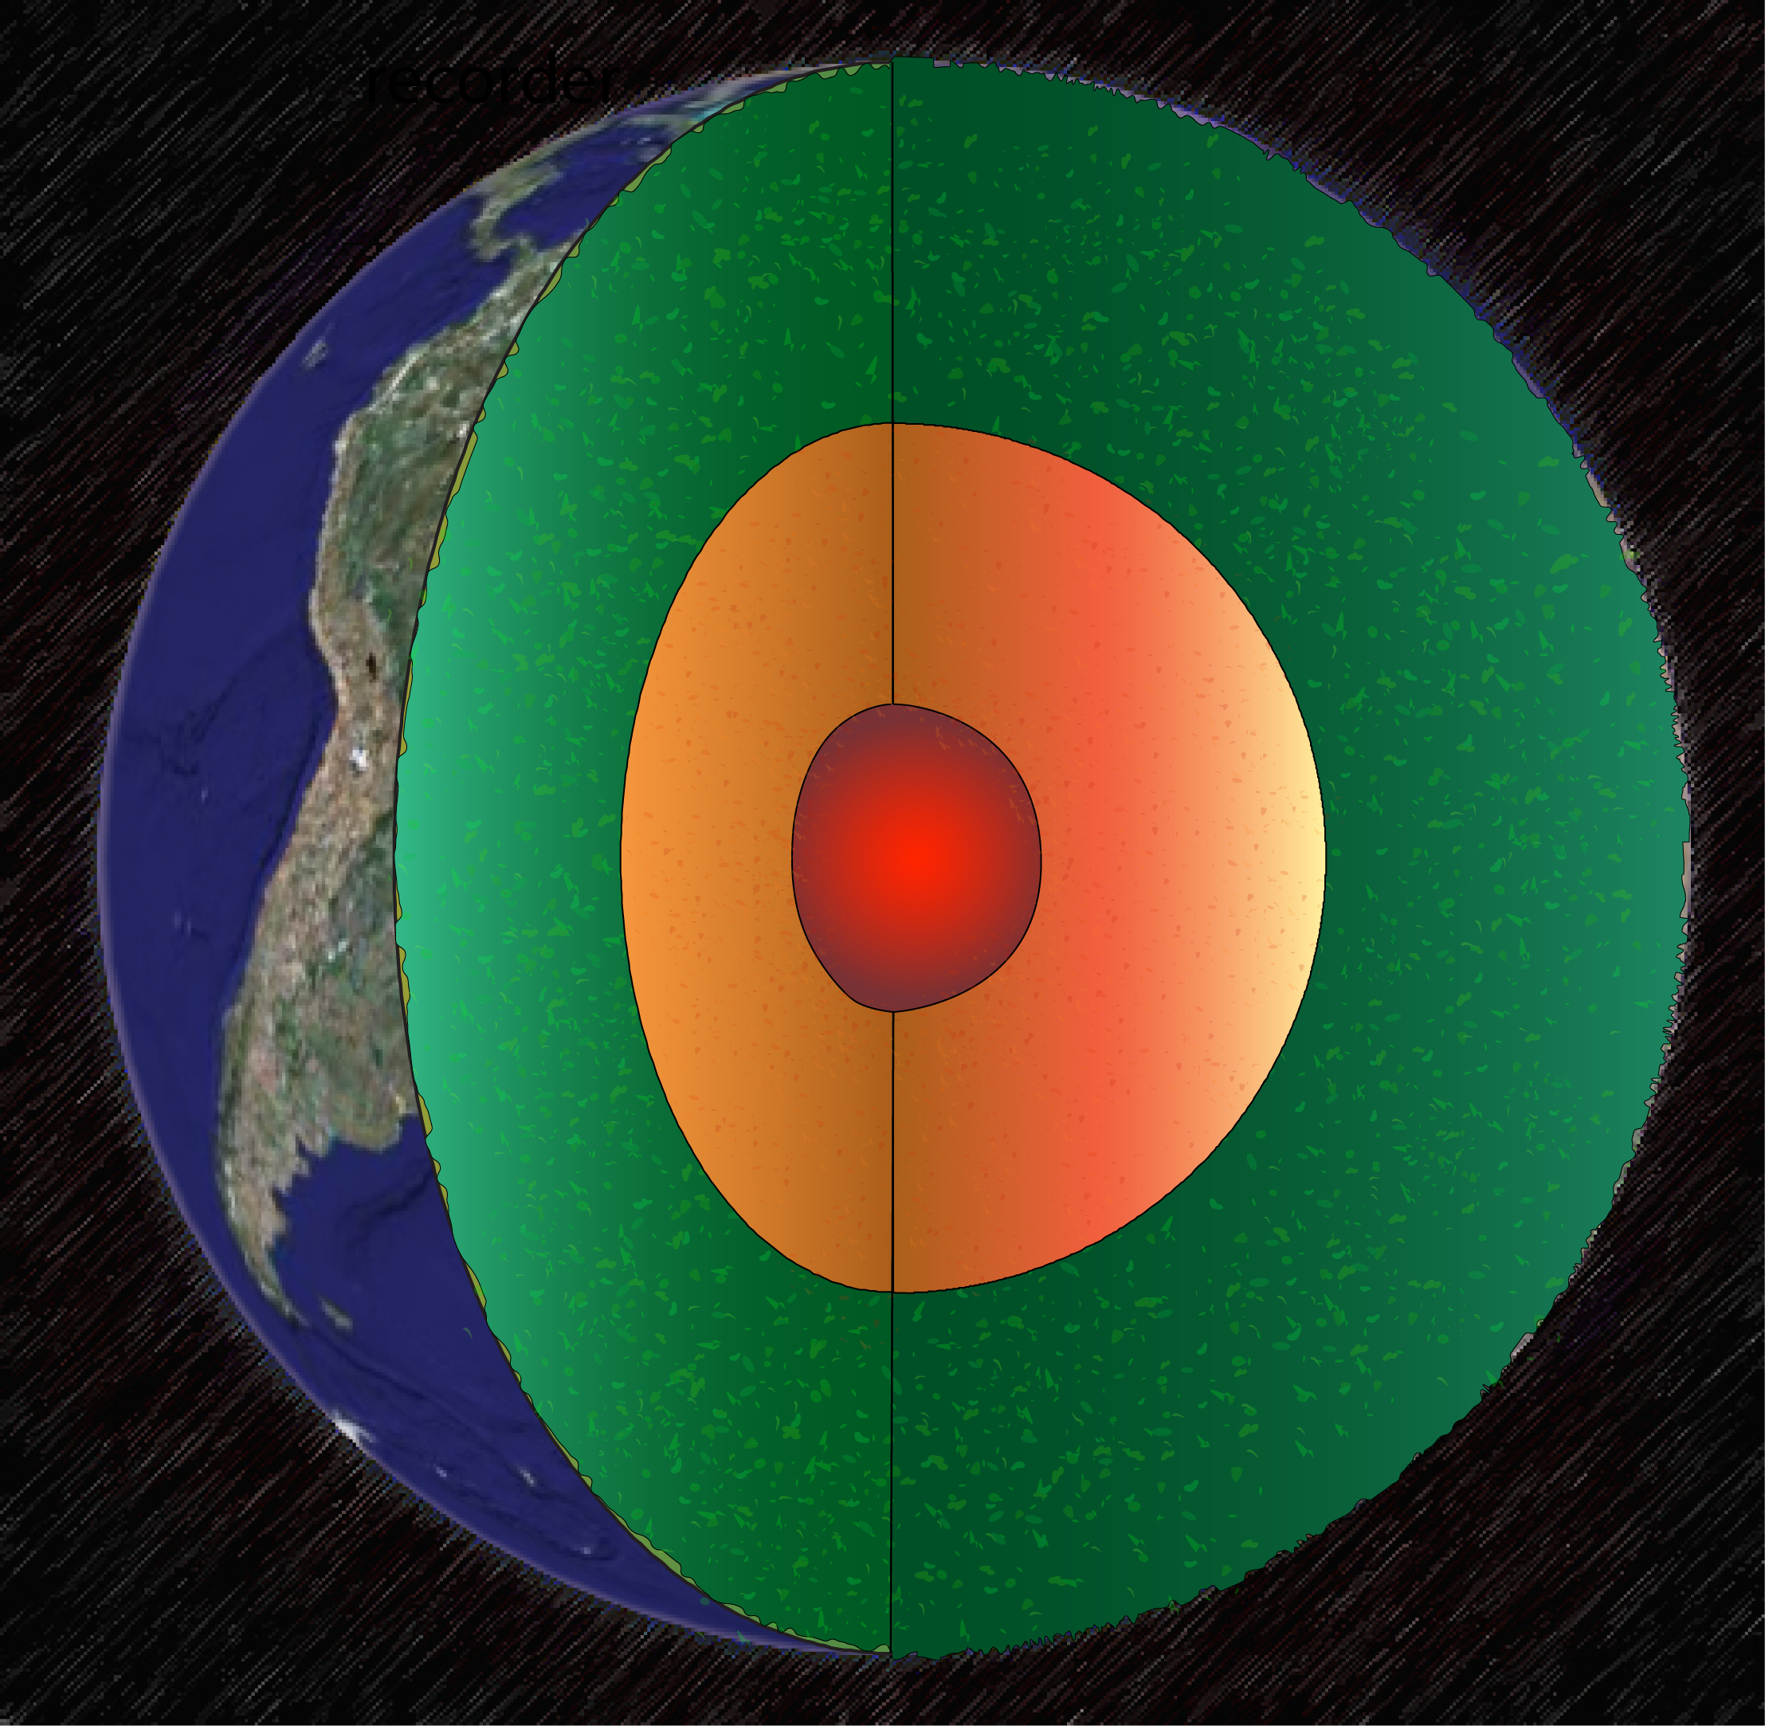


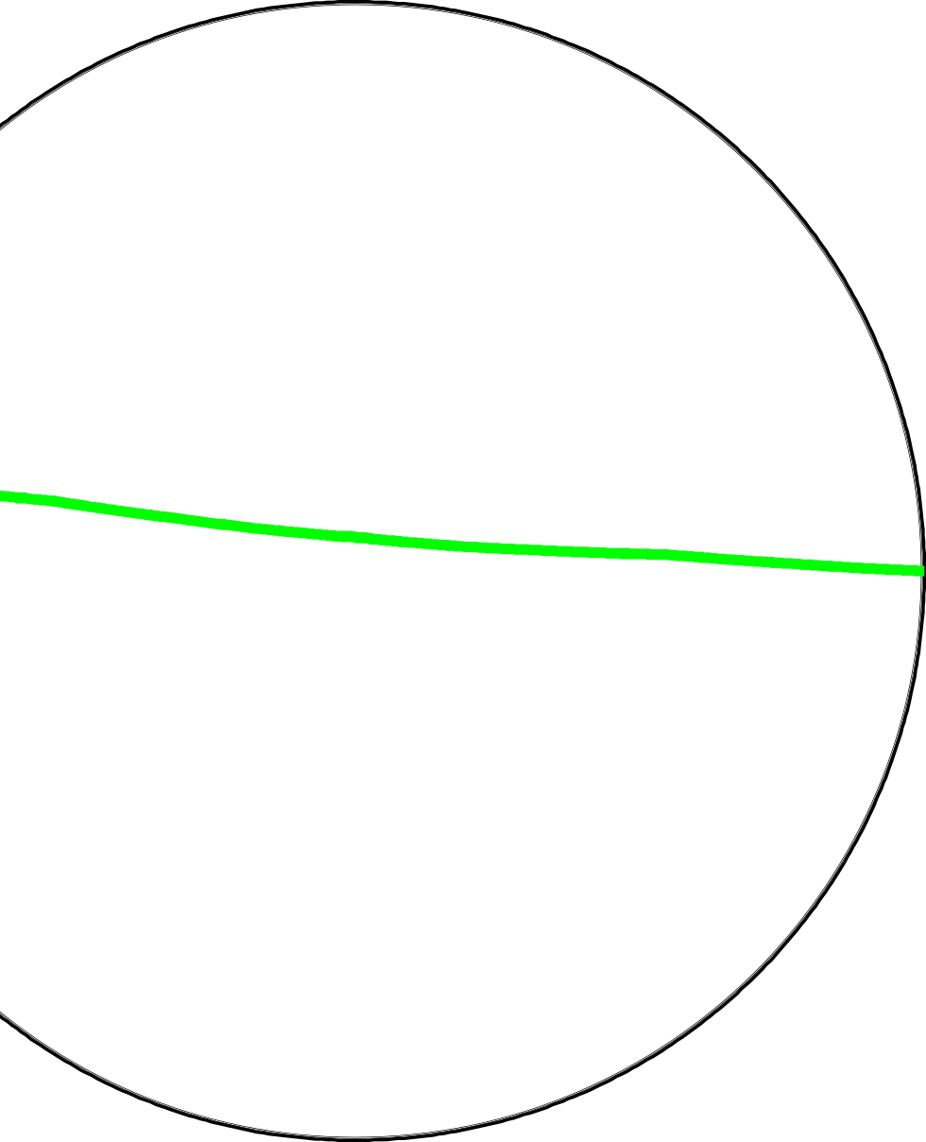
Core complexities
North Pole
South Pole
South Pole
Notes:
Some of these seismic waves travel through the Earth’s inner core.
By looking at these waves we’ve found that the speed of the seismic wave through the inner core depends on the direction that it travels.
CLICK
CLICK
Waves travelling parallel to the rotation axis are faster than waves travelling in the plane of the equator.
CLICK
This wiggle, the wave going through the Earth’s core in a polar direction, arrives about 8 seconds before it’s supposed to according to our predictions
CLICK
This wiggle, a wave going through the Earth’s core in the equatorial direction, arrives at the time it’s predicted
Given that the distance through the inner core is the same for these two waves, this tells us that the polar direction is faster.
We find that the seismic wavespeed in the inner core is about 5% faster in the polar direction.
This doesn’t sound like much, but these waves travel at 6 miles per second, so its nearly an extra half mile per second faster when waves travel parallel to the poles

Slide 15
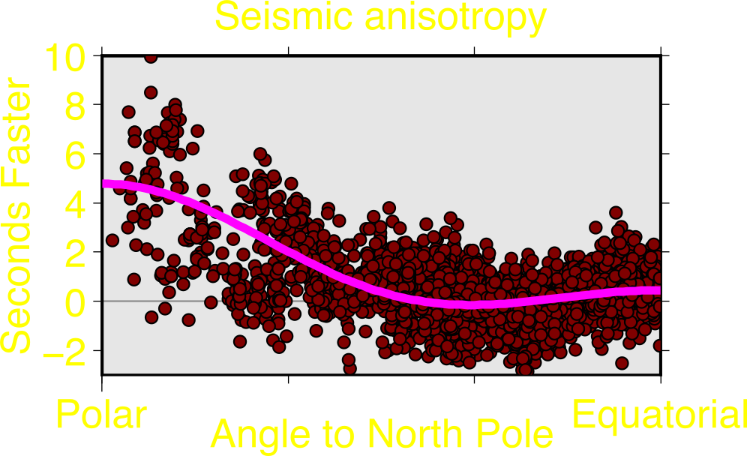
Core complexities
North Pole
South Pole
South Pole
Notes:
We make many measurements of the seismic wavespeed through the inner core at different directions relative to the rotation axis.
Most of our observations, shown by these red dots, show that the inner core is fast parallel to the rotation axis, and slow parallel to the equator
The other dots that don’t fit the smooth curve point to other patterns in the inner core

Slide 16

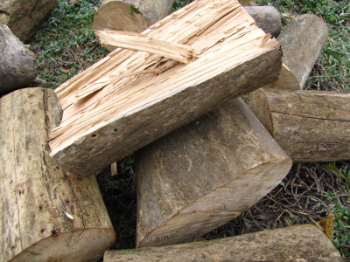

Core complexities
North Pole
Anisotropy
vs
Isotropy
South Pole
South Pole
Notes:
We refer to this feature as anisotropy, which means “not the same”, in contrast with “isotropy”, which means “the same”
An anisotropic material has different material properties depending on direction, while an isotropic material looks the same in all directions
CLICK
For example wood is anisotropic.
It’s hard against the grain, but weaker, and easier to split, along the grain. The strength of the wood depends on the direction you cut it.
In the case of seismic anisotropy, the seismic wavespeed depends on the direction that the wave travels.

Slide 17
Core complexities
North Pole
Anisotropy
vs
Isotropy
West
West
South Pole
South Pole
Notes:
We also find that, unlike the rest of the Earth which is concentric, the strongest anisotropy is not in Earth’s centre, but is offset to the West (under Brazil)
But why does the anisotropy, and its location matter?
Because this tells us what the inner core is made of and how the inner core moves
But again, seismology only shows us the present day, it’s like an X-ray image of the Earth today, and we’ve only been doing seismology for 100 years, far too short a time to measure the inner core moving
We can use crystals to tell us about this movement

Slide 18
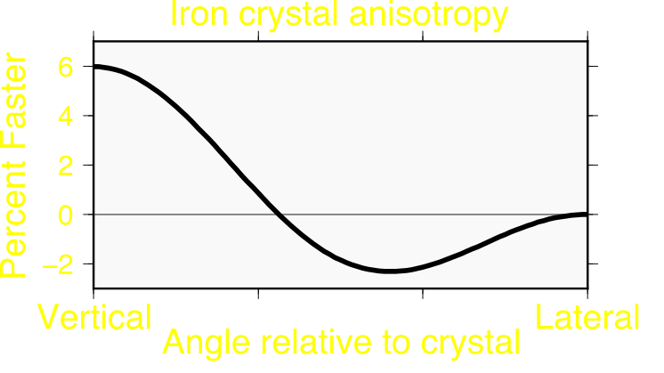

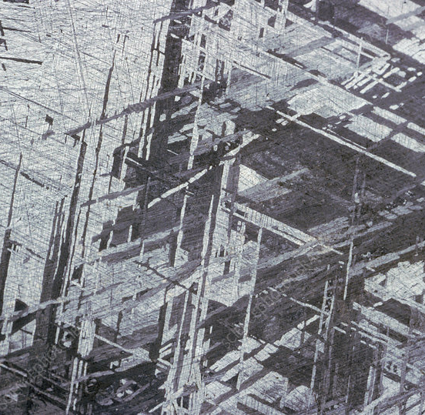
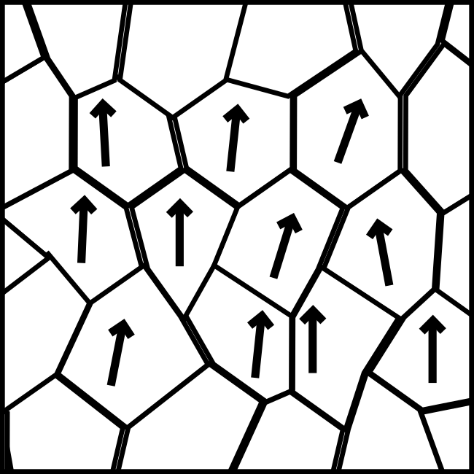
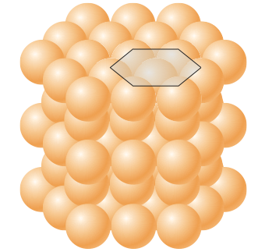
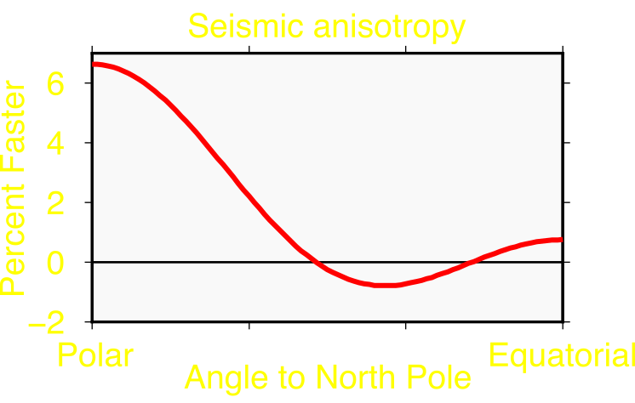
One direction
Notes:
We have reason to believe that the Earth’s inner core is a solid block of iron, composed of many crystals
This is a piece of a meteorite, which was probably the core of some planet that got destroyed early in the life of our solar system
This piece has many iron crystals which are long and thin, so likely anisotropic.
CLICK
A single iron crystal itself is intrinsically anisotropic, waves would travel through it at different speeds depending on direction
CLICK
Measurements of iron at the pressure and temperature of the inner core show that it’s anisotropy looks like that we observe with seismic waves
So if we plucked out a single crystal of the inner core, it would have the same anisotropy as we observe seismically for the whole of the inner core
CLICK
But that’s just one crystal that is anisotropic
CLICK
In an inner core that’s 2000 miles across
CLICK
If all of the crystals in the inner core pointed in different directions, we wouldn’t have any anisotropy
But for the whole of the inner core to have the character of one crystal, all of the other crystals have to look similar, meaning that they all have to point in the same direction.
We need to align the individual crystals to make the anisotropy point in the same one direction.
CLICK
Then our whole inner core would be anisotropic.

Slide 19

One direction
Notes:
To align crystals we need flow
Lots of things move, flow, and change direction.
We’re looking at a crowd of people on Black Friday.
CLICK
Look at how they’re disorderly and random
Then we open the doors and everyone points in the same direction, even these people sneaking in from the side.
Iron Crystals behave in a similar way: they start off random, then align when they move.

Slide 20
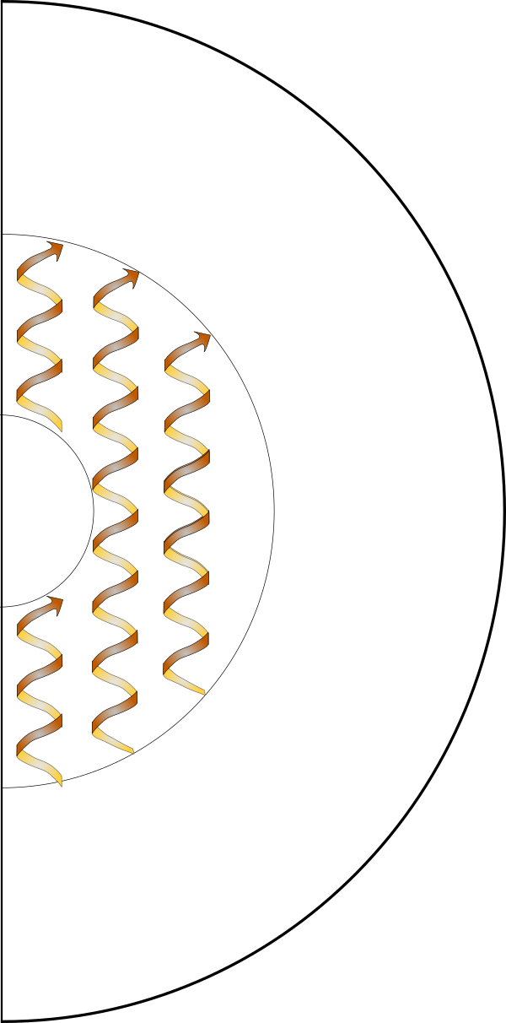

Equatorial expansion
North Pole
South Pole
South Pole
Notes:
Because of Earth’s rotation and the way in which the outer core convects, we think that the inner core will grow faster at the equator than at the poles.
CLICK
This would create an ellipsoid-shaped inner core
CLICK
However, ellipsoids aren’t very gravitationally stable, and so gravity will drag the core back into a spherical shape
CLICK
The involves pulling in from the equator, and pushing up towards the poles.
CLICK
This sets up a flow that aligns crystals as the core grows to its present size.
CLICK
Overall, the crystals all point in the same direction like one big crystal.
The strongest flow is in the centre, so the strongest anisotropy will be in the centre
CLICK
But seismology tells us that the strongest anisotropy is offset from the centre

Slide 21
Lost in translation
Translation/sliding direction
Notes:
Given this pattern of growth, how can could we grow an inner core that’s offset?
CLICK
The answer is asymmetric growth
If we grow more on one side of the inner core than the other, so crystals grow faster here than here,
We grow the inner core away from the original centre
CLICK
If we repeat this process we slowly translate the inner core, sliding it from one side to the other, and the original centre becomes offset.
CLICK
Thus our strongest flow is offset, so our strongest alignment is offset, so our strongest anisotropy is also offset
This hypothesis matches all of our seismic observations, thus it’s a compelling explanation for how the inner core grows.

Slide 22
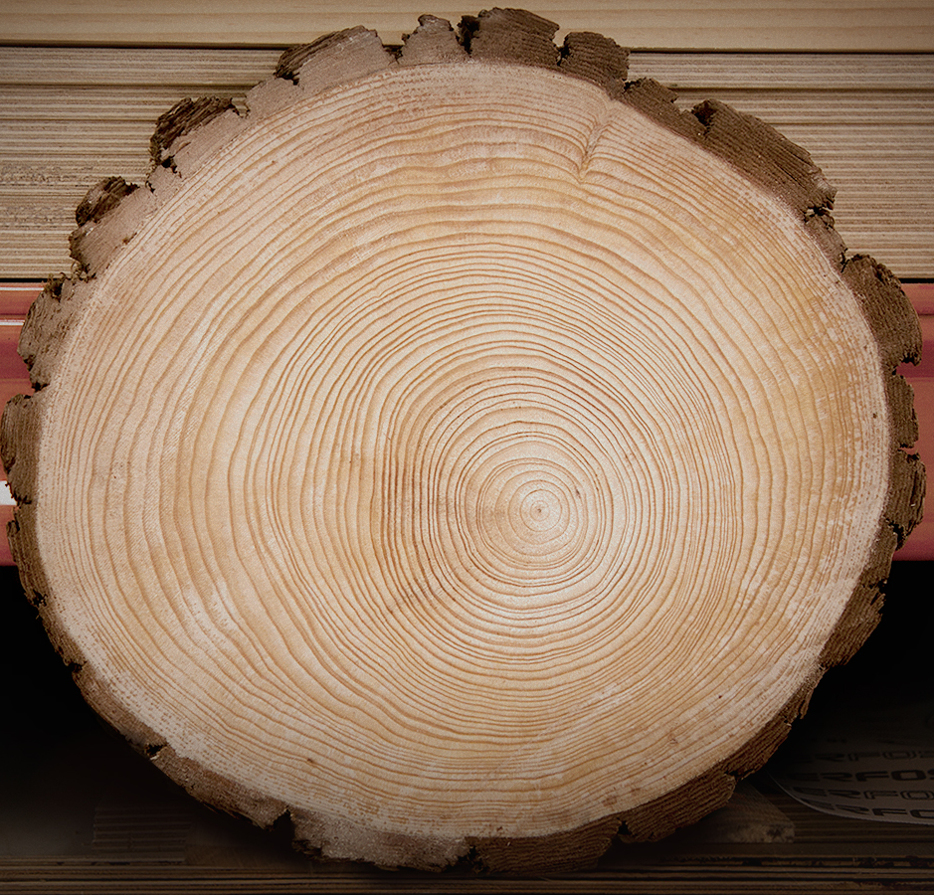
Growth rings
Notes:
In the end, when we slice our inner core,
CLICK
we see tree rings, tracking its movement
So, that’s how, standing here on the Earth’s surface, can take a single snapshot of the Earth today, and we can work out what the inner core been doing for the last half a billion years.

